Slide 1
CSE 4101
Lecture 5
Topic: Conjunctive Normal Form, Disjunctive Normal Form
Reasoning

Slide 2

Conjunctive Normal Form
A literal is an atomic formula (formula that has no logical connectives or equivalently that has no strict sub formulas) or its negation.
A clause is either a single literal of disjunction of two or more literals.
A statement is in conjunctive normal form if it is a conjunction (sequence of ANDs) consisting of one or more conjuncts (joined together), each of which is a disjunction (OR) of one or more literals

Slide 3
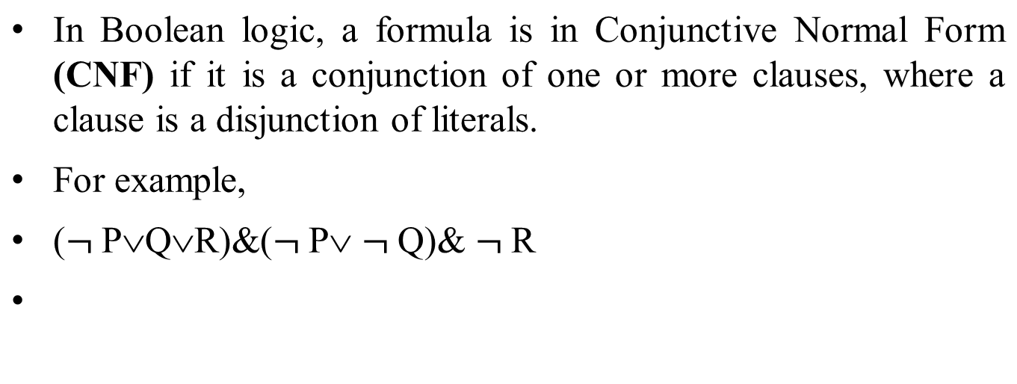
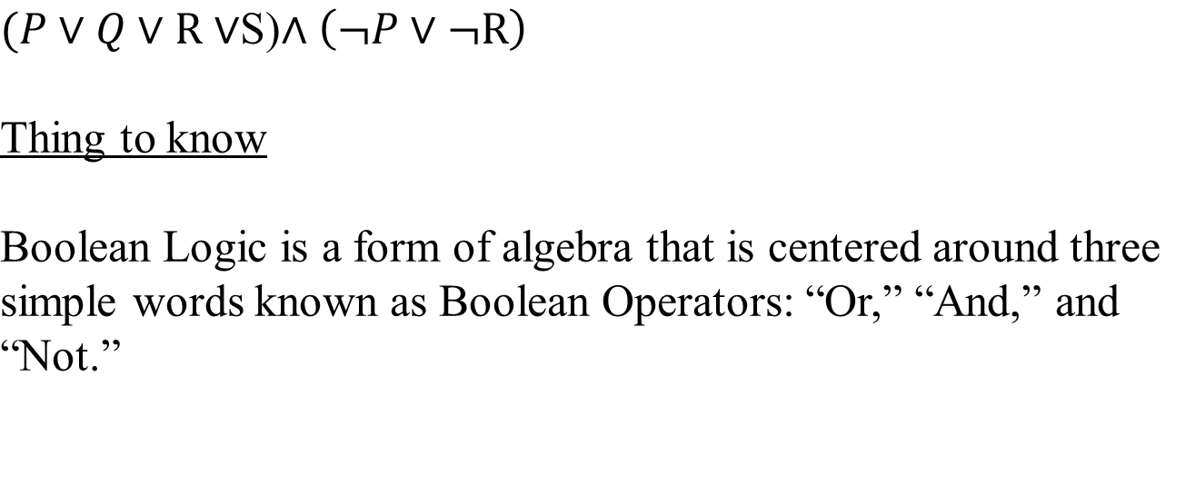
Conjunctive Normal Form

Slide 4
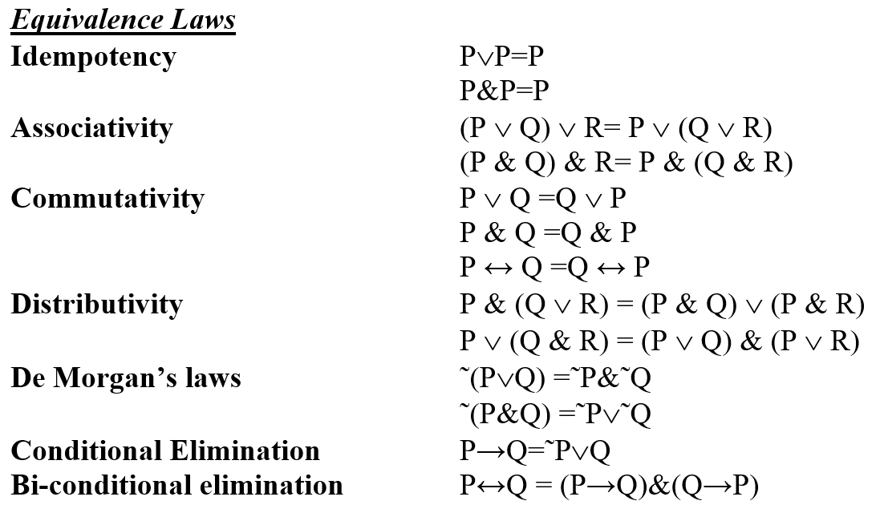
Equivalence Law

Slide 5
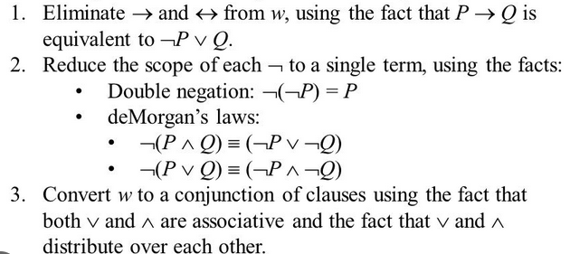
How to Convert to Conjunctive normal form

Slide 6
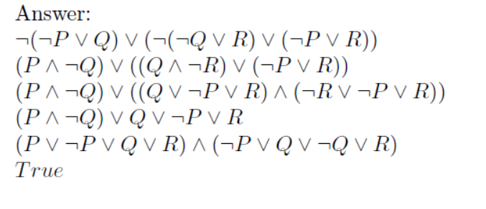
How to Convert to Conjunctive normal form

Slide 7
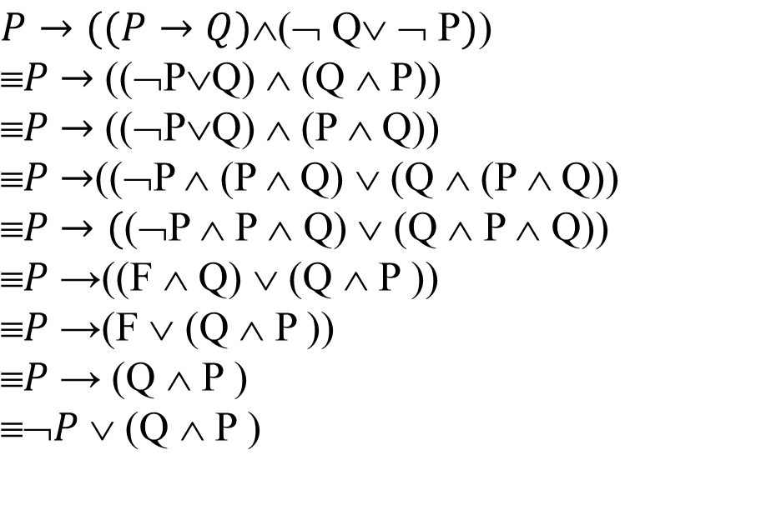
Convert the following into Conjunctive normal form

Slide 8
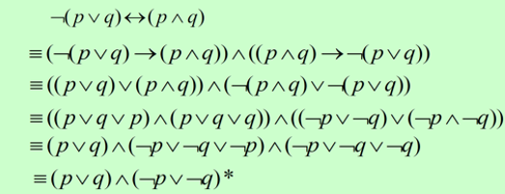
Example 1:Convert the following formula into conjunctive formal form.

Slide 9
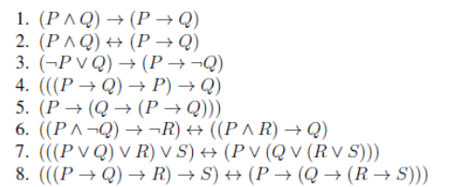
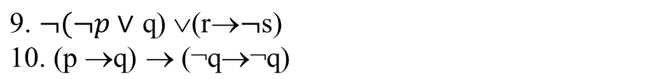
Convert the following into conjunctive normal form

Slide 10
Disjunction Normal Form
A formula is in disjunctive normal form (DNF), if it is a disjunction of conjunctions of literals.
Example:
(p ∧ q ∧ r) ∨ (p ∧ ¬q ∧ r ∧ s) ∨ (¬p ∧ ¬q)
(p ∧ ¬q)
(A ∧ ¬B) ∨ (¬A ∧ B)
p ∨ (¬p ∧ q) ∨ (¬p ∧ ¬q ∧ r) ∨ (¬p ∧ ¬q ∧ ¬r ∧ w)
(¬p ∧ q) ∨ (¬p ∧ ¬q ∧ r) ∨ (¬p ∧ ¬q ∧ ¬r ∧ w)

Slide 11
Covert the following into disjunctive normal form
Eliminate → and ↔ using logical identifies.
Use De-Morgans laws to eliminate ¬ before sums of products.
Apply distributive laws repeatedly to eliminate product of sums. The resulting formula will be sum of products of literals.

Slide 12
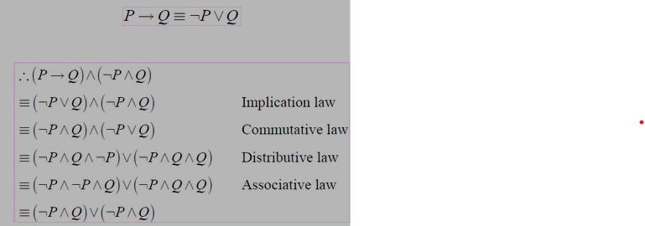
Covert the following into disjunctive normal form

Slide 13
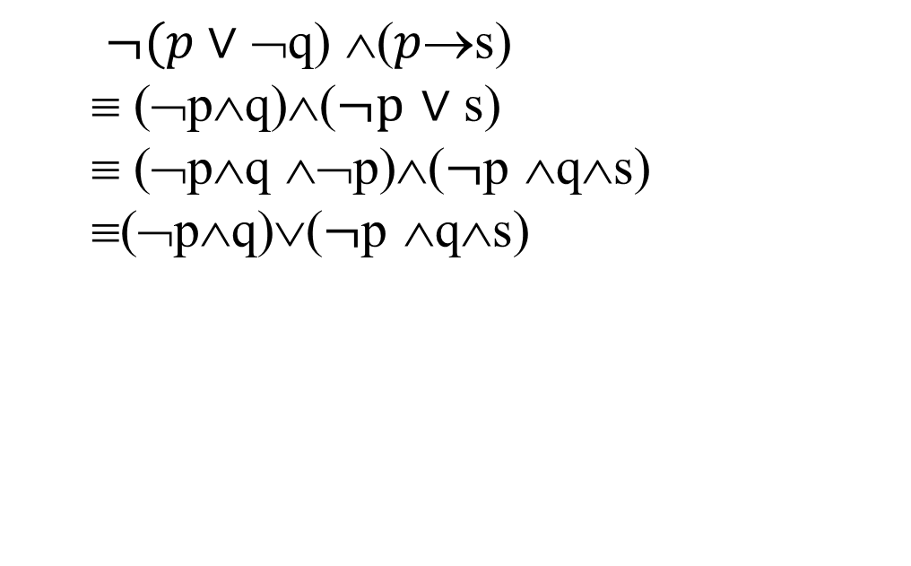
Covert the following into disjunctive normal form

Slide 14
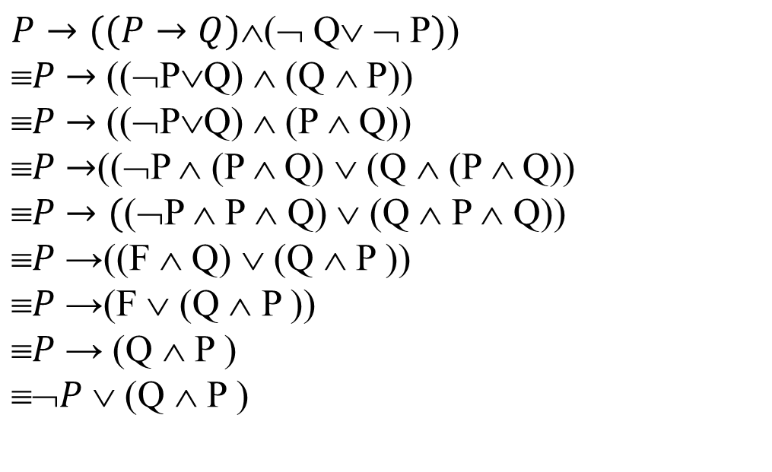
Covert the following into disjunctive normal form

Slide 15
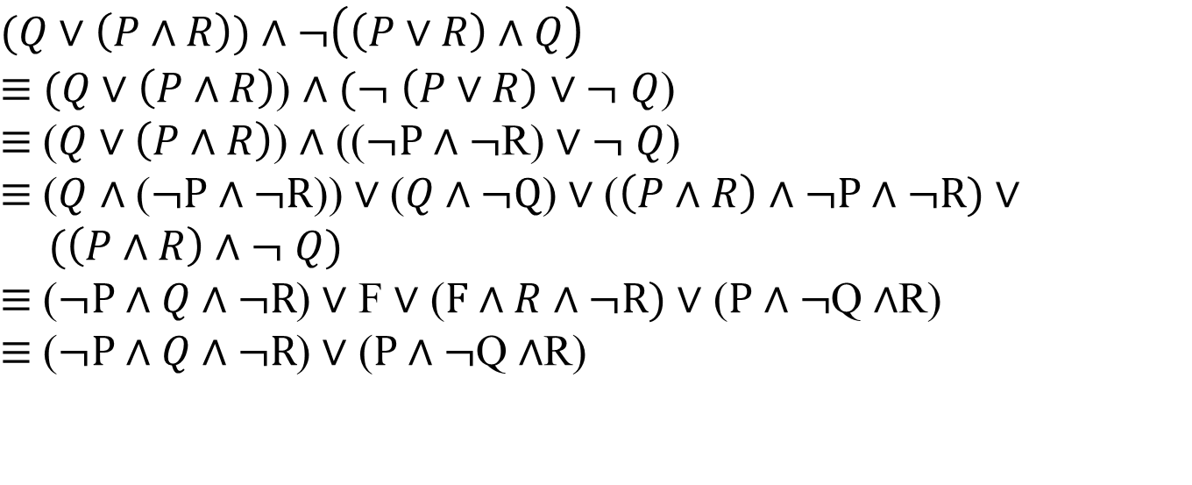
Covert the following into disjunctive normal form

Slide 16
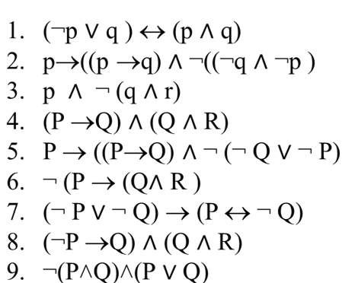
Covert the following into disjunctive normal form

Slide 17
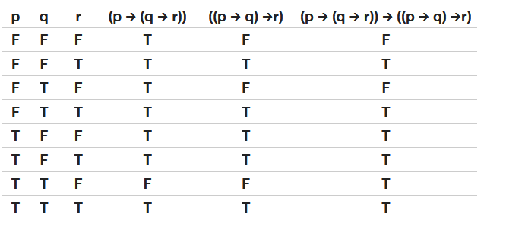
With the aid of the truth table convert the expression into disjunctive normal form
(p → (q → r)) → ((p → q) →r)
Therefore Disjunctive Normal Form (¬p ∧ ¬q ∧ r ) v (¬p ∧ q ∧ r ) v ( p ∧ ¬q ∧ ¬r ) v (p ∧ ¬q ∧ r ) v (p ∧ q ∧ ¬r ) v (p ∧ q ∧ r )

Slide 18
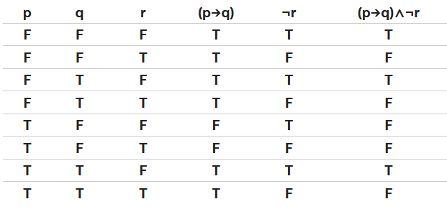

With the aid of aid of the truth table convert the expression into disjunctive normal form
(p→q)∧¬r
Therefore Disjunctive Normal Form

Slide 19
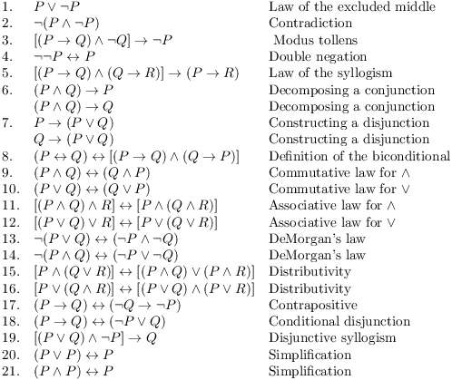
Equivalence laws

Slide 20
Reasoning:
The reasoning is the mental process of deriving logical conclusion and making predictions from available knowledge, facts, and beliefs. Or we can say, "Reasoning is a way to infer facts from existing data." It is a general process of thinking rationally, to find valid conclusions. Determine the type of Reasoning.
A premise is a proposition—a true or false declarative statement—used in an argument to prove the truth of another proposition called the conclusion.
An axiom, postulate, or assumption is a statement that is taken to be true, to serve as a premise or starting point for further reasoning and arguments.

Slide 21
Reasoning:
A premise is a proposition—a true or false declarative statement—used in an argument to prove the truth of another proposition called the conclusion.
An axiom is a statement or proposition which is regarded as being established, accepted, or self-evidently true.
an 'implication' involves both a premise and a conclusion, similar to an if-then statement- 'If I eat too much then I will be sick.

Slide 22
Reasoning:
Deductive reasoning
Deductive reasoning starts with a general assumption, it applies logic, then it tests that logic to reach a conclusion. With this type of reasoning, if the premises are true, then the conclusion must be true. Example:
Premise-1: All the human eats veggies
Premise-2: Suresh is human.
Conclusion: Suresh eats veggies.

Slide 23
Reasoning:
Inductive reasoning
Inductive reasoning starts with a specific assumption, then it broadens in scope until it reaches a generalized conclusion. With inductive reasoning, the conclusion may be false even if the premises are true.
Example:
Premise: All of the pigeons we have seen in the zoo are white.
Conclusion: Therefore, we can expect all the pigeons to be white.

Slide 24
Reasoning:
Abductive reasoning
Abductive reasoning is a predictive inference in which we guess the most likely conclusion given a specific set of premises.
Abductive reasoning typically begins with an incomplete set of observations and proceeds to the likeliest possible explanation for the set.
Example:
Implication: Cricket ground is wet if it is raining
Axiom: Cricket ground is wet.
Conclusion: It is raining.

Slide 25
Reasoning:
Common Sense reasoning
Common sense reasoning is an informal form of reasoning, which can be gained through experiences. Common Sense reasoning simulates the human ability to make presumptions about events which occurs on every day. It relies on good judgment rather than exact logic and operates on heuristic knowledge and heuristic rules. Examples:
One person can be at one place at a time.
If I put my hand in a fire, then it will burn.

Slide 26
Reasoning:
Monotonic Reasoning
Monotonic means something that does not vary or change. In monotonic reasoning, once the conclusion is taken, then it will remain the same even if we add some other information to existing information in our knowledge base.
Example:
Earth revolves around the Sun.
It is a fact that cannot be changed, even if we add another sentence to our knowledge base, such as "The moon revolves around the earth" or "The Earth is not round," and so on.

Slide 27
Reasoning:
Non-Monotonic Reasoning
Non-monotonic Reasoning is the process that changes its direction or values as the knowledge base increases. Nonmonotonic reasoning can be described as a theory of making and revising assumptions in a reasoned or principled way
Example: Let suppose the knowledge base contains the following knowledge:
“Consider a bowl of water. If we put it on the stove and turn the flame on it will obviously boil hot and as we will turn off the flame it will cool down gradually,”

Slide 28
Reasoning
Bumping into people annoys them.
All three of a couple's children have brown eyes, therefore any other children they have will have brown eyes.
The waitress must have noticed I wasn’t enjoying my meal, that’s probably why she offered to get me something else to eat instead
The waitress must have noticed I wasn’t enjoying my meal, that’s probably why she offered to get me something else to eat instead
Dr. Martha is that he is a lecturer at a university. She used to teach Mathematics in the Department. If we later learn that he is doing PhD research. She is the then busy in the lab that retract our former conclusion about her teaching classes.

Slide 29
Reasoning
Determine the type of Reasoning:
You get what you pay for.
All birds have feathers. All robins are birds. Therefore, robins have feathers.
All zebras have stripes; tigers have stripes; therefore, tigers are zebras.
All the children in this daycare center like to play with Lego. All children must like to play with Lego.
A vehicle will not get through a red light in time.
The children in that house yell loudly when they play in their bedroom. I can hear children yelling in that house. Therefore, the children must be playing in their bedroom.
If it is sunny, we are not watching tv. We are watching tv. So, it must not be sunny.

Slide 30
Reasoning
Determine the type of Reasoning:
You get what you pay for.
Perch, salmon, and trout are all fish, and all have gills, therefore all fish have gills.
If all students in a math class failed the final exam, and Trey is in the math class, then Trey failed the final exam.
All three of a couple's children have brown eyes, therefore any other children they have will have brown eyes.
Water is tasteless, colorless and odorless,
All swans are white. Jane is white. Therefore, Jane is a swan.
You cannot remember events that have not yet happened.
These are my favorite jeans and I can’t fit into them anymore. I must have gained weight.

